Slide 1









My Number Interactive Notebook
$$×$$
$$\frac{1}{2}$$
$$÷$$
$$+$$
$$−$$
$$\frac{3}{5}$$
$$7$$
Name
Class
Teacher
Term 1 Semester 1
$$5^{2}$$
$$\sqrt{9}$$
1

Slide 2
Contents
Glossary or Formula Page
Page
Date
Description
2
3

Slide 3
Tasks
24
7
30
Essential Question
Questions
Notes
Summary
6
7

Slide 4
24
7
30
Date
Index Laws
EQ – Describe how the index laws can be used to simplify expressions with indices.
5

Slide 5

Task –Expand the following
$3^{2}$
$3^{5}$
$3^{7}$
$3^{2}×3^{5}$
$3^{7}×3^{2}$
$\frac{3^{7}}{3^{5}}$
$3^{5}÷3^{2}$

Slide 6

24
7
30
Date
Index Laws
EQ – Describe how the index laws can be used to simplify expressions with indices.
What are the index laws?
Index Law
Example
$$a^{m}×a^{n}=a^{m+n}$$
5

Slide 7

24
7
30
Date
Index Laws
EQ – Describe how the index laws can be used to simplify expressions with indices.
What are the index laws?
Index Law
Example
$$a^{m}×a^{n}=a^{m+n}$$
$$x^{7}×x^{4}=x^{7+4}=x^{11}$$
Index Law 2
5

Slide 8



24
7
30
Date
Index Laws
EQ – Describe how the index laws can be used to simplify expressions with indices.
What are the index laws?
Index Law
Example
$$a^{m}×a^{n}=a^{m+n}$$
$$x^{7}×x^{4}=x^{7+4}=x^{11}$$
Index Law 2
$$a^{m}÷a^{n}=a^{m−n}$$
5

Slide 9


24
7
30
Date
Index Laws
EQ – Describe how the index laws can be used to simplify expressions with indices.
What are the index laws?
Index Law
Example
$$a^{m}×a^{n}=a^{m+n}$$
$$x^{7}×x^{4}=x^{7+4}=x^{11}$$
Index Law 2
$$a^{m}÷a^{n}=a^{m−n}$$
$$x^{7}÷x^{4}=x^{7−4}=x^{3}$$
5

Slide 10
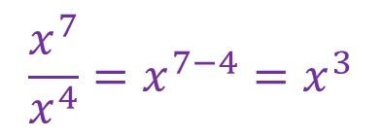

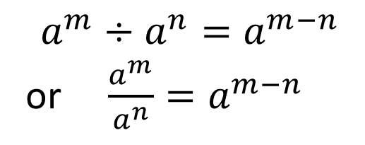
24
7
30
Date
Index Laws
EQ – Describe how the index laws can be used to simplify expressions with indices.
What are the index laws?
Index Law
Example
$$a^{m}×a^{n}=a^{m+n}$$
$$x^{7}×x^{4}=x^{7+4}=x^{11}$$
Index Law 2
$$a^{m}÷a^{n}=a^{m−n}$$
or $\frac{a^{m}}{a^{n}}=a^{m−n}$
$$x^{7}÷x^{4}=x^{7−4}=x^{3}$$
$$\frac{x^{7}}{x^{4}}=x^{7−4}=x^{3}$$
5

Slide 11
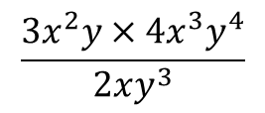

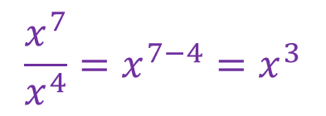

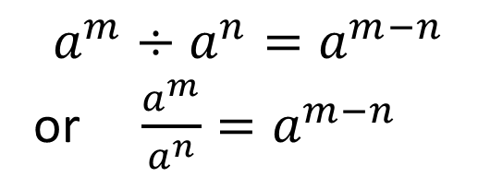
24
7
30
Date
Index Laws
EQ – Describe how the index laws can be used to simplify expressions with indices.
What are the index laws?
Index Law 1
Example
$$a^{m}×a^{n}=a^{m+n}$$
$$x^{7}×x^{4}=x^{7+4}=x^{11}$$
Index Law 2
$$a^{m}÷a^{n}=a^{m−n}$$
or $\frac{a^{m}}{a^{n}}=a^{m−n}$
$$x^{7}÷x^{4}=x^{7−4}=x^{3}$$
$$\frac{x^{7}}{x^{4}}=x^{7−4}=x^{3}$$
Example
Simplify
$$\frac{3x^{2}y×4x^{3}y^{4}}{2xy^{3}}$$
5

Slide 12
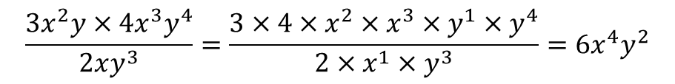
24
7
30
Date
Index Laws
EQ – Describe how the index laws can be used to simplify expressions with indices.
What are the index laws?
Index Law 1
Example
$$a^{m}×a^{n}=a^{m+n}$$
$$x^{7}×x^{4}=x^{7+4}=x^{11}$$
Index Law 2
$$a^{m}÷a^{n}=a^{m−n}$$
or $\frac{a^{m}}{a^{n}}=a^{m−n}$
$$x^{7}÷x^{4}=x^{7−4}=x^{3}$$
$$\frac{x^{7}}{x^{4}}=x^{7−4}=x^{3}$$
Example
Simplify
$$\frac{3x^{2}y×4x^{3}y^{4}}{2xy^{3}}=\frac{3×4×x^{2}×x^{3}×y^{1}×y^{4}}{2×x^{1}×y^{3}}=6x^{4}y^{2}$$
5

Slide 13
Task
Cambridge TextbooksPage 335 and 336

Slide 14
Notes Review
24, 7 ,30
Date
Title
Essential question
Notes complete
Notes complete with colour and diagrams
Questions completed
Contents page filed in
Formula page filled in

Slide 15
Homework
Review your notes and write a summary answering the essential question.

